Slide 1
Intro to Next Generation Sequencing Data Analysis with Galaxy
While we are waiting:
Connect to Tufts network (on campus or VPN)
Chrome browser https://galaxy.cluster.tufts.edu
Login with Tufts credentials
Let me know if you have trouble logging in
Rebecca Batorsky
Pr Bioinformatics Scientist
Nov 2021

Slide 2









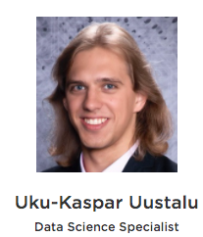
Research Technology Team
Consultation on Projects and Grants
High Performance Compute Cluster
Workshops
https://it.tufts.edu/research-technology

Slide 3
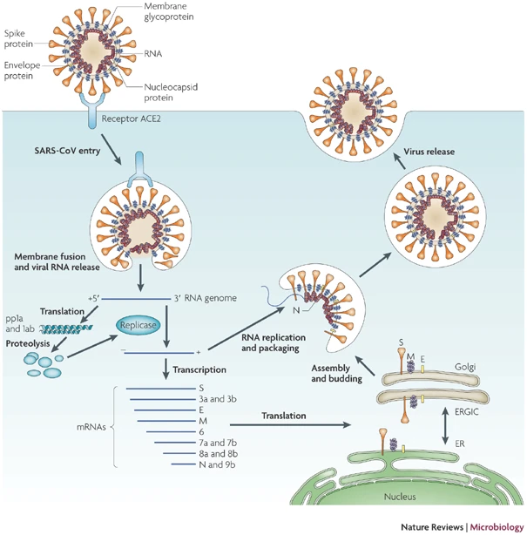
SARS-CoV2 Spike Protein
https://www.nature.com/articles/nrmicro2090
Notes:
Severe acute respiratory syndrome-coronavirus (SARS-CoV) enters target cells through an endosomal pathway. The Spike protein first binds to the cellular receptor angiotensin-converting enzyme 2 (ACE2)¹²⁹, and the ACE2–virus complex is then translocated to endosomes, entering the cell where downstream steps in the virus lifecycle take place.

Slide 4
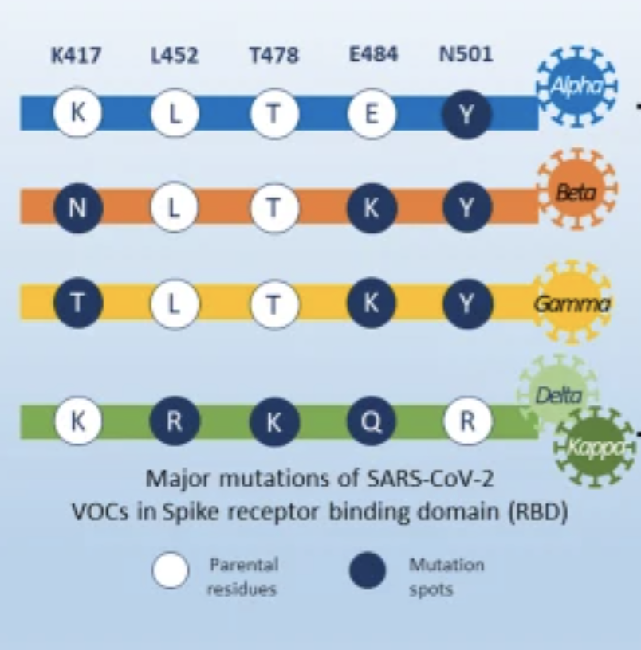
SARS-CoV2 Spike Protein VOCs
ACE2 affinity
Transmissibility
https://www.nature.com/articles/nrmicro2090
https://ccforum.biomedcentral.com/articles/10.1186/s13054-021-03662-x
Notes:
Severe acute respiratory syndrome-coronavirus (SARS-CoV) enters target cells through an endosomal pathway. The Spike protein first binds to the cellular receptor angiotensin-converting enzyme 2 (ACE2)¹²⁹, and the ACE2–virus complex is then translocated to endosomes, entering the cell where downstream steps in the virus lifecycle take place.
The major variant of concerns (VOCs) have shared mutations in severe acute respiratory syndrome coronavirus 2 (SARS-CoV-2) spike proteins and resulted in higher transmissibility rate and affect viral virulence and clinical outcome.

Slide 5
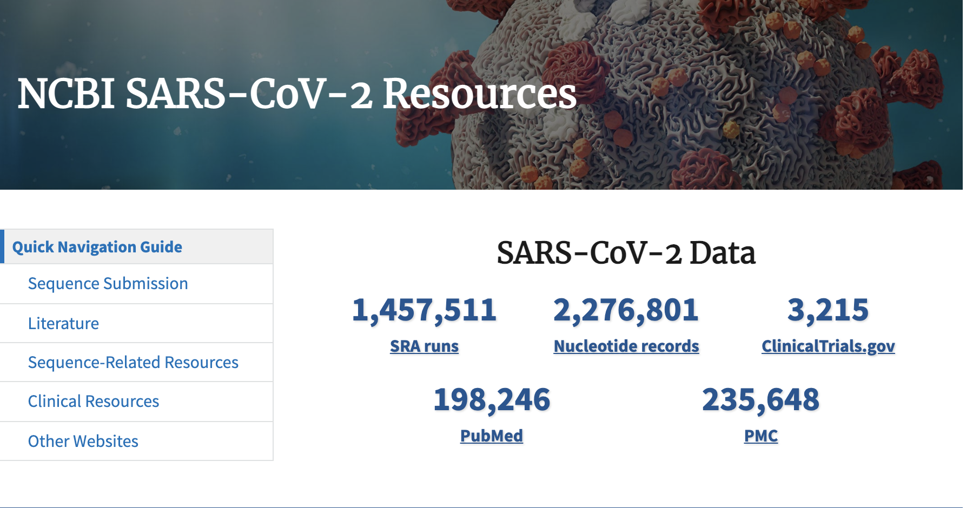
https://www.ncbi.nlm.nih.gov/sars-cov-2/
Notes:
The US National Center for Biotechnology Information hosts repositories for many types of biomedical and genomics data. Today we'll retrieve reference data from Nucleotide repository, which contains among other things sequence records for SARS-CoV2 genomes as well as the Sequence Read Archive (SRA) where raw next generation sequencing data can be easily obtained for reanalysis.

Slide 6
Outline
Introduction to the Galaxy Platform
Obtain data from NCBI
SARS-Cov-2 Alpha variant reference sequence
SARS-Cov-2 Delta variant NGS sample
Process Raw Reads (QC, adapter trimming)
Read Alignment
Visualization
Verify delta variant mutations relative to alpha variant sequence

Slide 7
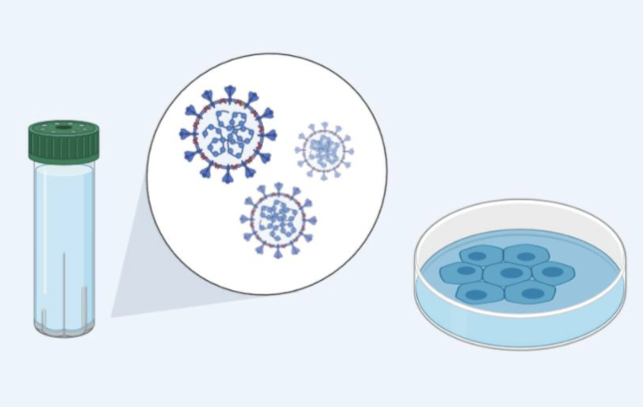
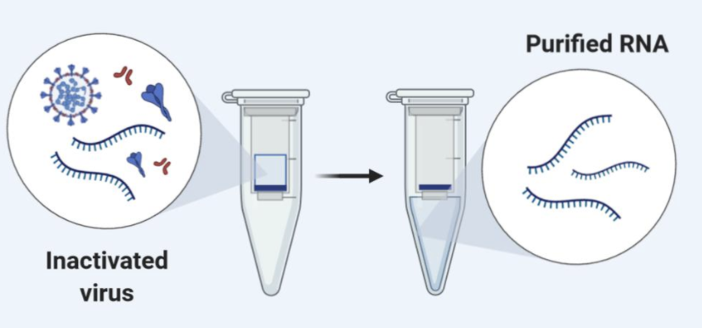
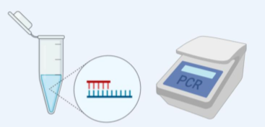
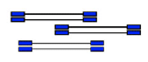
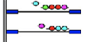

Viral Genome Next Generation Sequencing (NGS)
RNA extraction
cDNA synthesis using virus specific primers
Amplification
Specimen Collected
NGS library prep
NGS sequencing
Alignment
flowcell
Notes:
The process starts with a clinical sample collection, for respiratory viruses this is usually a nasal swab.
Then, total RNA is extracted from the sample, this contains both virus and host RNA.
At this point a decision is made about downstream protocol based on whether the virus is known.
In the case we will study, the authors are interested in sequencing SARS-CoV-2 which has a known sequence, so they can design virus specific primers which will capture SARS-CoV2 and not the host RNA, and transcribe it into complementary DNA which can be prepped for sequencing.
Importantly, the primers they design will limit what they capture, so they must design the primers to bind in regions that they expect are conserved between viral variants.
An amplification procedure has to be performed, because the current NGS technologies require a high input DNA amount and the viral genome amount is several orders of magnitude lower.
Then, the preparation for NGS sequencing begins.
We start with viral cRNA fragments that can be sequenced the same as DNA on an NGS sequencer.
Sequencing adapters are added (these are the blue rectangles) that will allow the cDNA fragments to attach to the sequencing flowcell.
I won’t go in depth through the sequencing process, but the sequence of the fragments is determined using fluorescently tagged nucleotides that emit a colored light signal when they attach to a base on the fragment being sequences. It is the optical signal that the instrument reads to determine which base in the sequence was read.

Slide 8
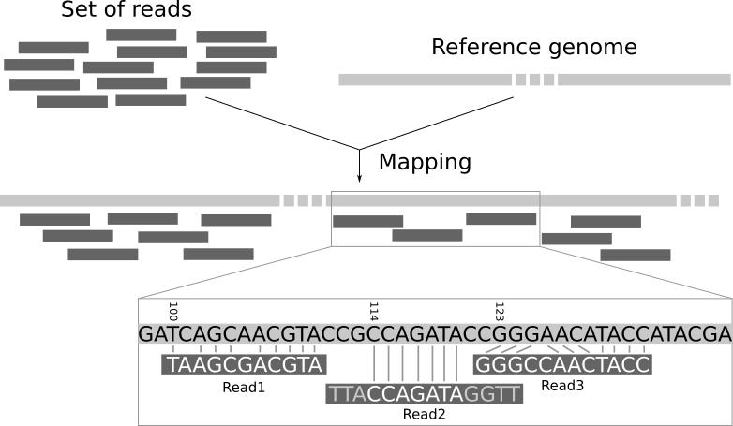
High level intro to Short Read Alignment
Notes:
Here is a high level description of the mapping process. The input consists of a set of reads and a reference genome. In the middle, it gives the results of mapping: the locations of the reads on the reference genome. The first read is aligned at position 100 and the alignment has two mismatches. The second read is aligned at position 114. It is a local alignment with clippings on the left and right. The third read is aligned at position 123. It consists of a 2-base insertion and a 1-base deletion.

Slide 9
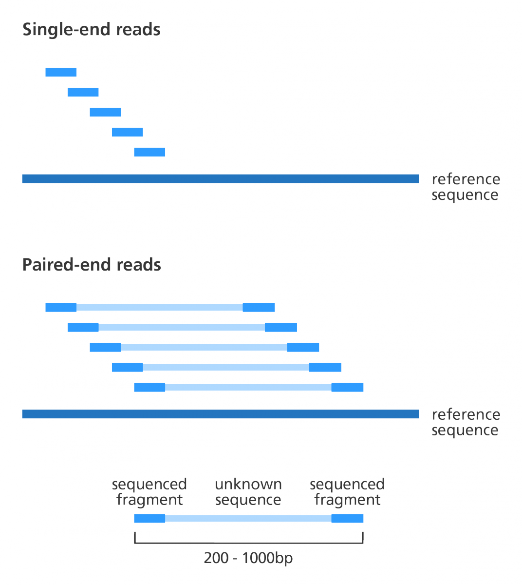
Paired end vs Single end reads
cDNA fragment
https://www.biostars.org/p/267167/
Notes:
NGS sequencing can generate single end reads and paired end reads, our sample today consists of paired end reads.
The basic difference is that for single end reads, one side of the cDNA fragment is sequenced, with paired end sequencing, the fragment is flipped over on the flowcell so that both sides of the fragment can be sequenced.
Thus, two reads “paired” are generated from each side of the fragment. They may not cover the entire fragment.
Paired read sequencing typically gives more accurate sequencing information for each sequenced fragment, both because fragments are sequenced in two directions, and because it’s possible to link sequence fragments that are at some distance from each others. This is especially useful in virus samples, where different viral variants may be present in the same sample.

Slide 10
Outline
Introduction to the Galaxy Platform
Obtain data from NCBI
Process Raw Reads (QC, adapter trimming)
Read Alignment
Visualization

Slide 11
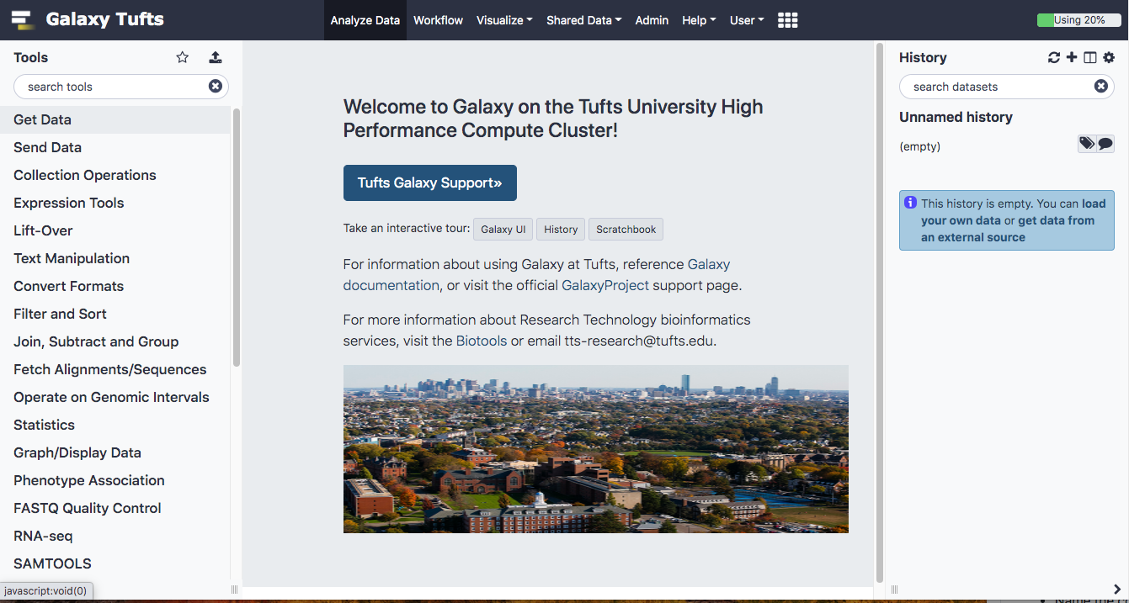
Log into Galaxy
Connect to Tufts Network, either on campus or via VPN
Visit https://galaxy.cluster.tufts.edu
Log in with you Tufts credentials

Slide 12

Galaxy on the Tufts HPC
HPC Cluster
node | node | node | node
node | node | node | node
User laptop
Proxy web-server
(Apache)
Job scheduler
(SLURM)
PAM Authentication
PostgreSQL Database server
Galaxy web-server
Notes:
Our Galaxy server runs on the HPC cluster, storing data on HPC drives and using compute nodes and Slurm scheduler to run user jobs
In practice, this means that Tufts users have more resources on Tufts’ Galaxy compared to public servers
We also have the ability to install and configure open source and custom tools
More information on getting access to Tufts Galaxy can be found on the Research Technology website

Slide 13
User Interface
Notes:
We’ll spend some time getting familiar with the Galaxy interface, layout, and key functions

Slide 14
User Interface
TOP MENU BAR
TOOLS
HISTORY
MAIN
Notes:
The Galaxy User Interface has a top menu bar and three panels: Tools, Main, and History

Slide 15
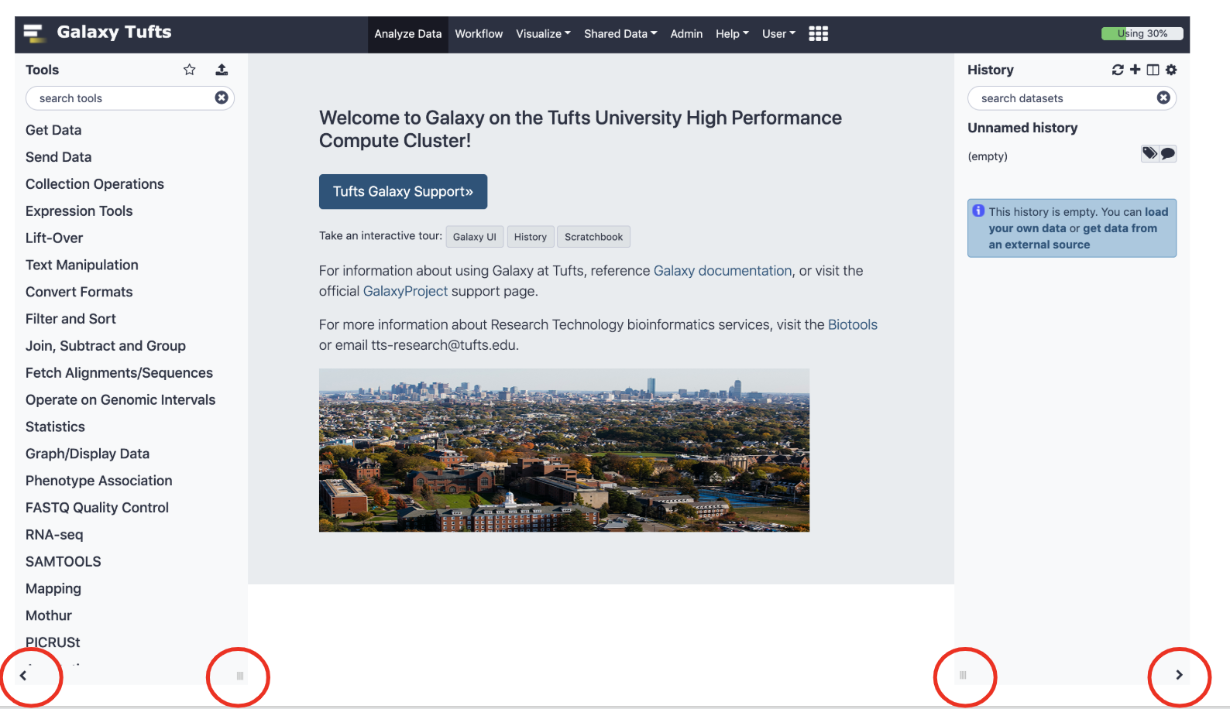
Galaxy User Interface
To return to home screen
Minimize/Adjust toolbars
Notes:
The panels can be expanded/minimized using the small arrows and dragging the three small lines in the bottom left and right corners of the page
To get back to the home page click the logo next to Galaxy Tufts on the top left of the page or the Analyze Data tab on the top of the page

Slide 16
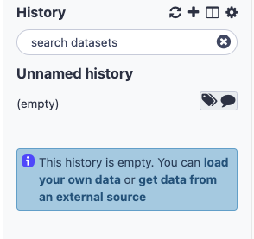
History
Create New History
View all Histories
Notes:
Histories are where a dataset and a set of analysis are stored
Similar to a “working directory”.
You can have multiple histories under the same account and you can view them all by clicking the + as shown below

Slide 17
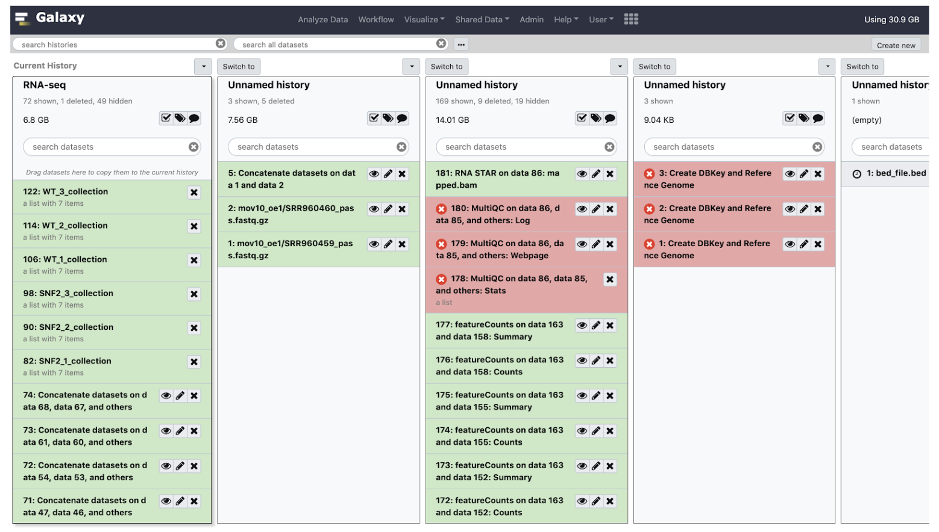
History
Create New History
View all Histories
Notes:
Histories are where a dataset and a set of analysis are stored
Similar to a “working directory”.
You can have multiple histories under the same account and you can view them all by clicking the + as shown below

Slide 18
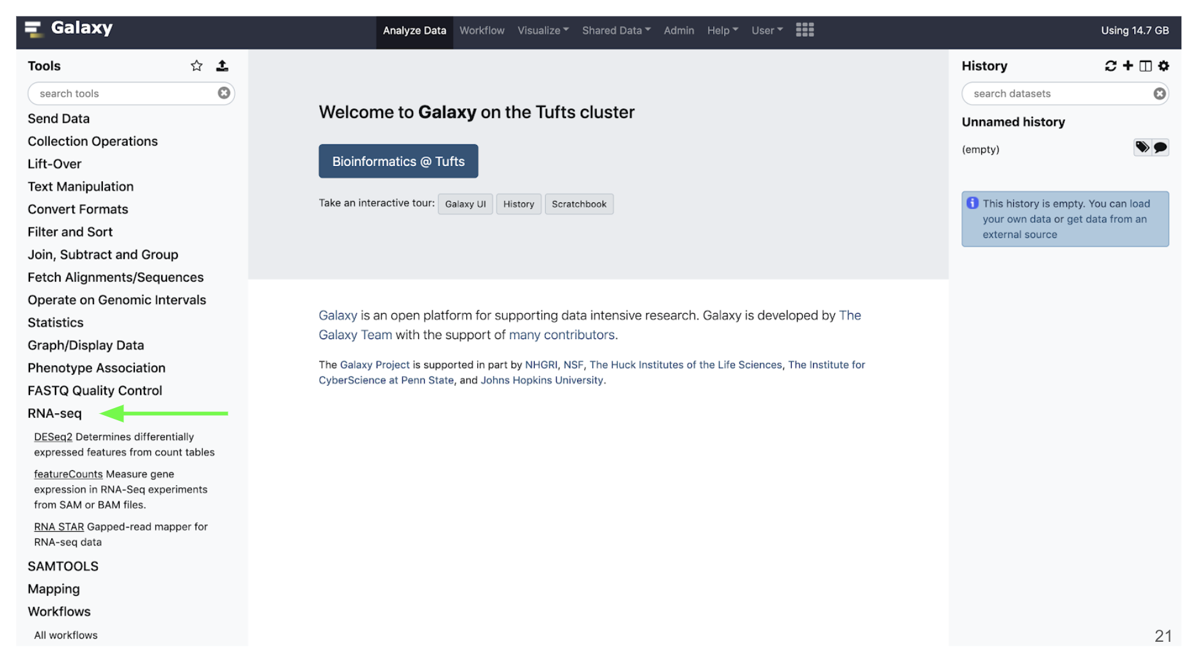
Tools
Notes:
On the Tools panel, either search by name or click the category that your tool would fall under
For example for RNAseq analysis, they will be stored under the RNA-seq category
Tools for alignment will be under the Mapping category

Slide 19
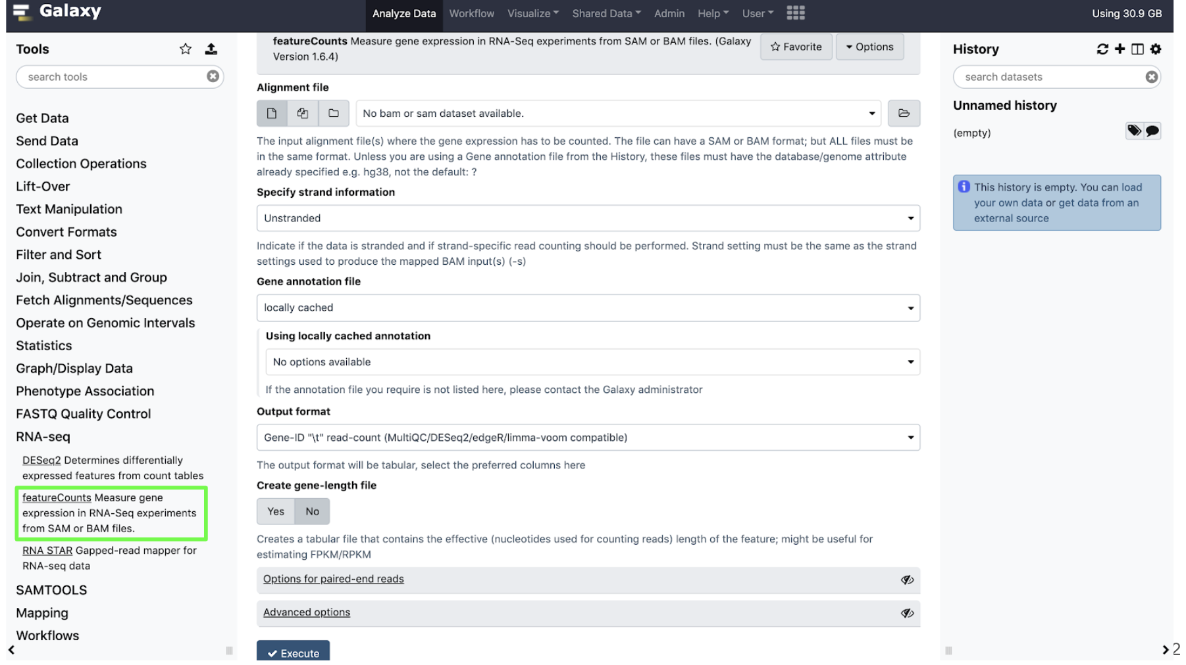
Tools
Click on the name of the tool
to open it in the main panel
Notes:
Click the name of the tool you would like to use and the tool menu will appear in the Main panel.
With that brief introduction to the Tool, Main and History panels, we’ll walk through an NGS sequencing data analysis example.

Slide 20
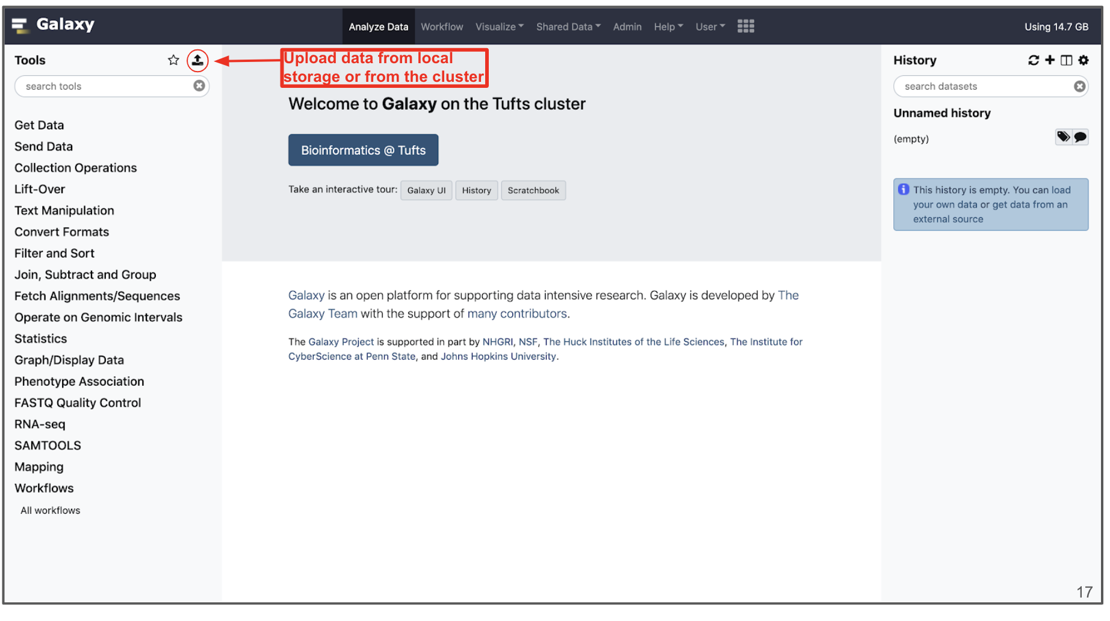
Importing data
Notes:
Data can be uploaded to Galaxy in a number of ways by clisking the “Upload” icon on the top of the Tools panel.

Slide 21
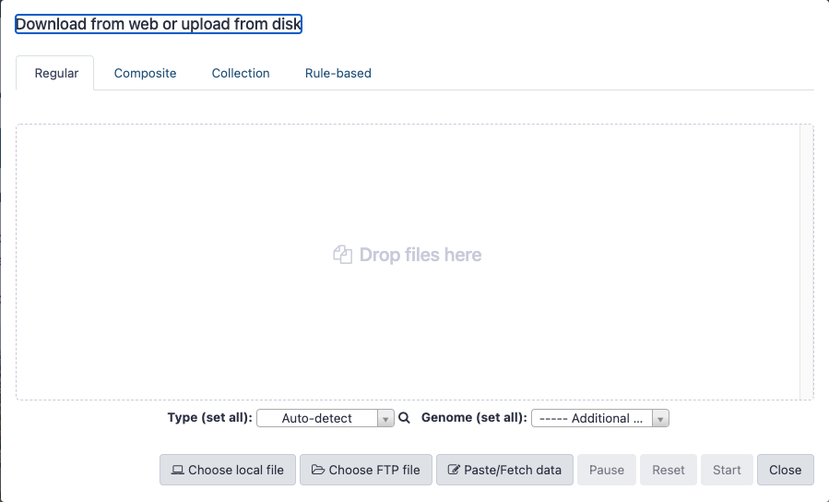
Importing data
Cluster directory
/cluster/tufts/galaxy/xfer/username
From Computer
Internet
Notes:
Data can be uploaded to Galaxy in a number of ways by clisking the “Upload” icon on the top of the Tools panel.

Slide 22
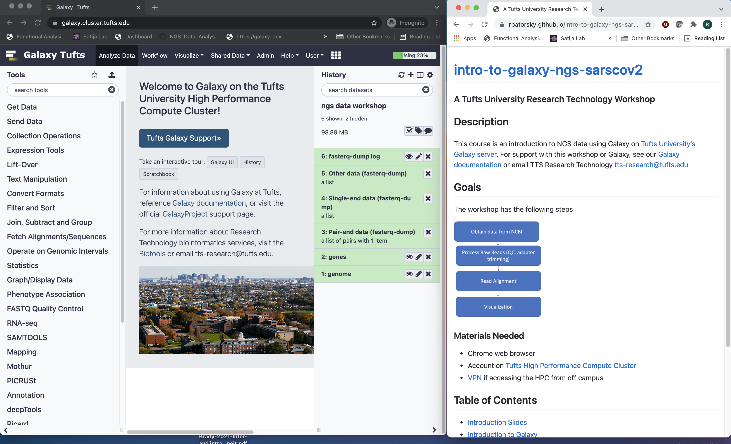
Log into Galaxy and open course website
Connect to Tufts Network, either on campus or via VPN
Visit https://galaxy.cluster.tufts.edu
Log in with you Tufts credentials
Visit course website https://rbatorsky.github.io/intro-to-galaxy-ngs-sarscov2
Suggested layout

Slide 23
Outline
Introduction to the Galaxy Platform
Obtain data from NCBI
SARS-Cov-2 Alpha variant reference sequence
SARS-Cov-2 Delta variant NGS sample
Process Raw Reads (QC, adapter trimming)
Read Alignment
Visualization

Slide 24
NGS details

Slide 25
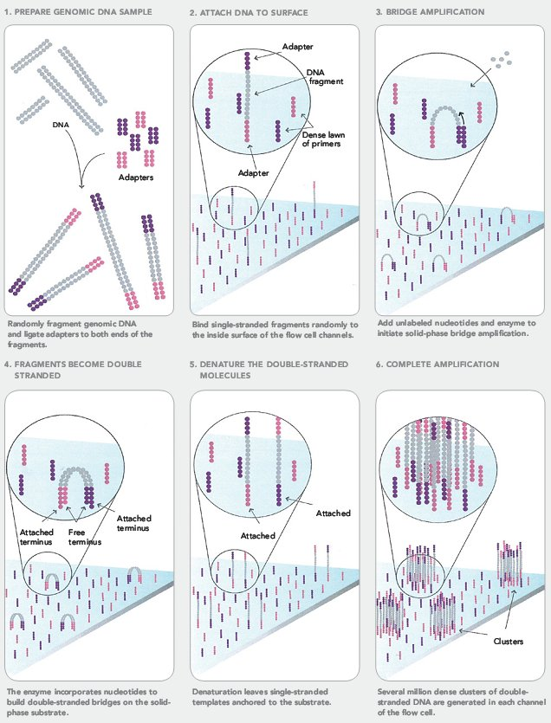
Next Generation Sequencing (NGS)
https://sites.google.com/site/himbcorelab/illumina_sequencing

Slide 26
Next Generation Sequencing (NGS)
https://sites.google.com/site/himbcorelab/illumina_sequencing

Slide 27
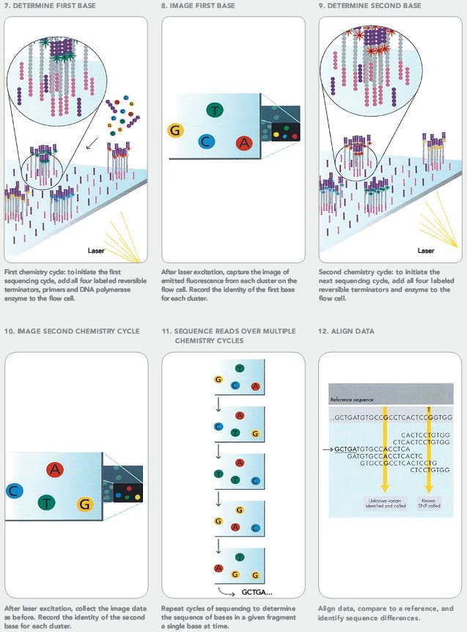
Next Generation Sequencing (NGS)
https://sites.google.com/site/himbcorelab/illumina_sequencing

Slide 28
Next Generation Sequencing (NGS)
This Illumina video is great for visualization!
https://sites.google.com/site/himbcorelab/illumina_sequencing

Slide 29
FastQC

Slide 30



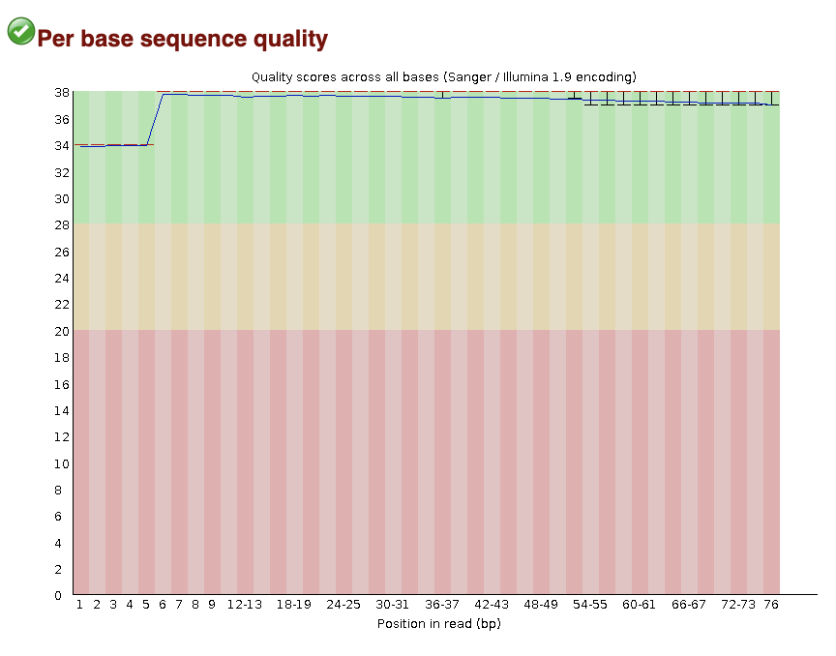
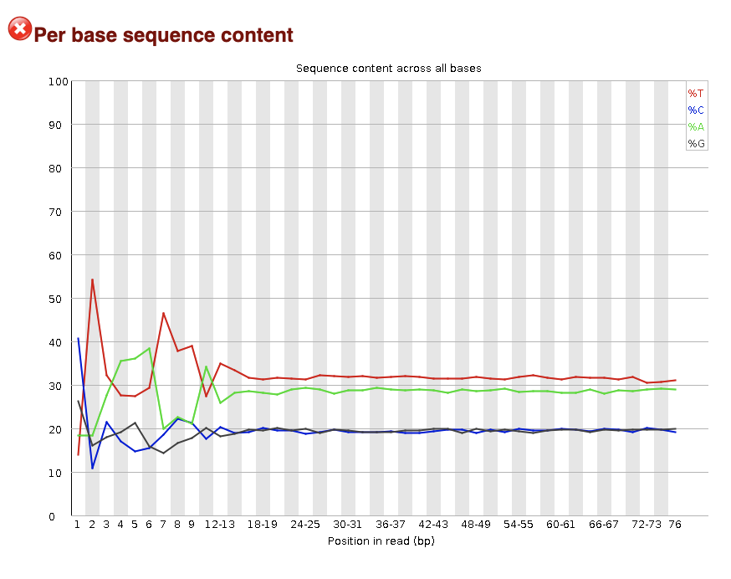
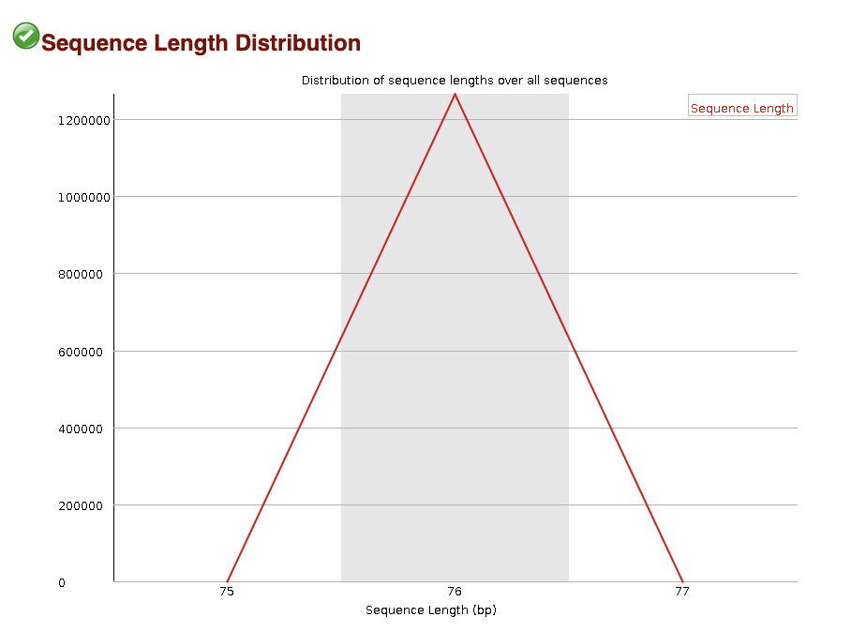

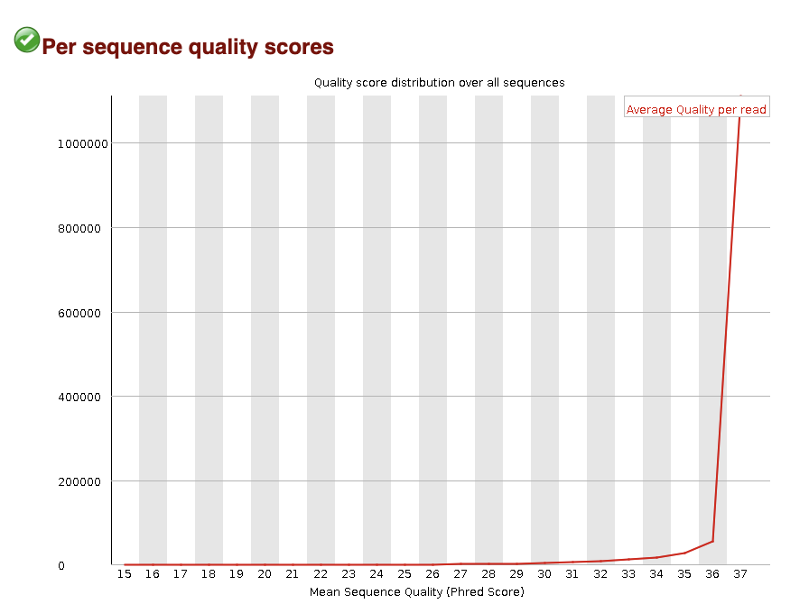

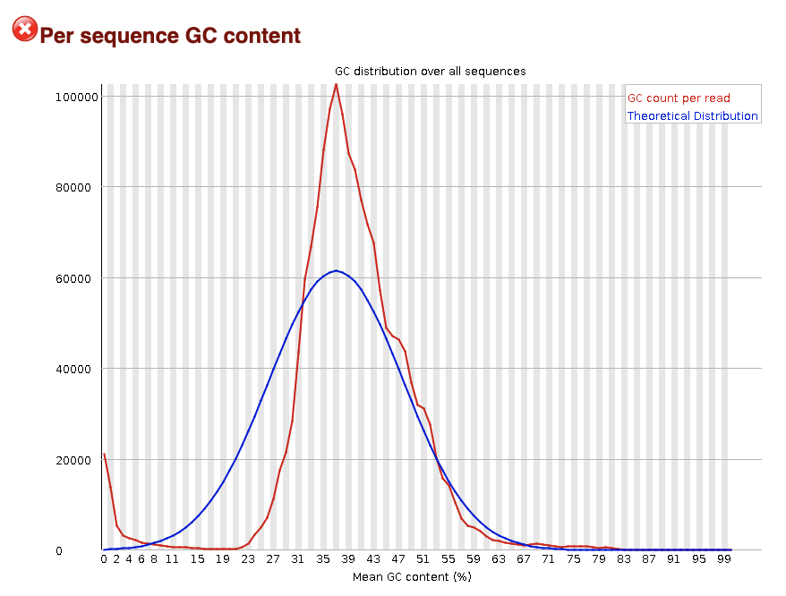

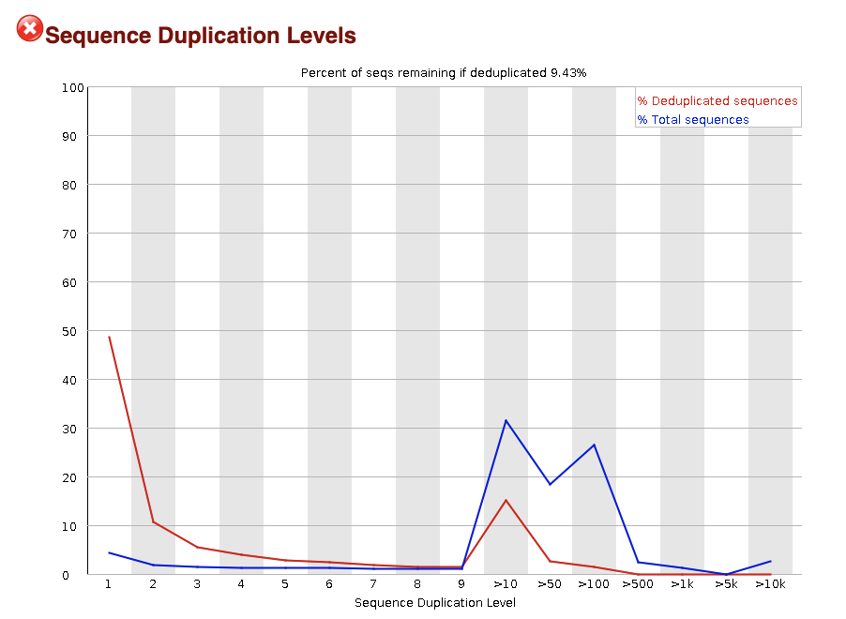

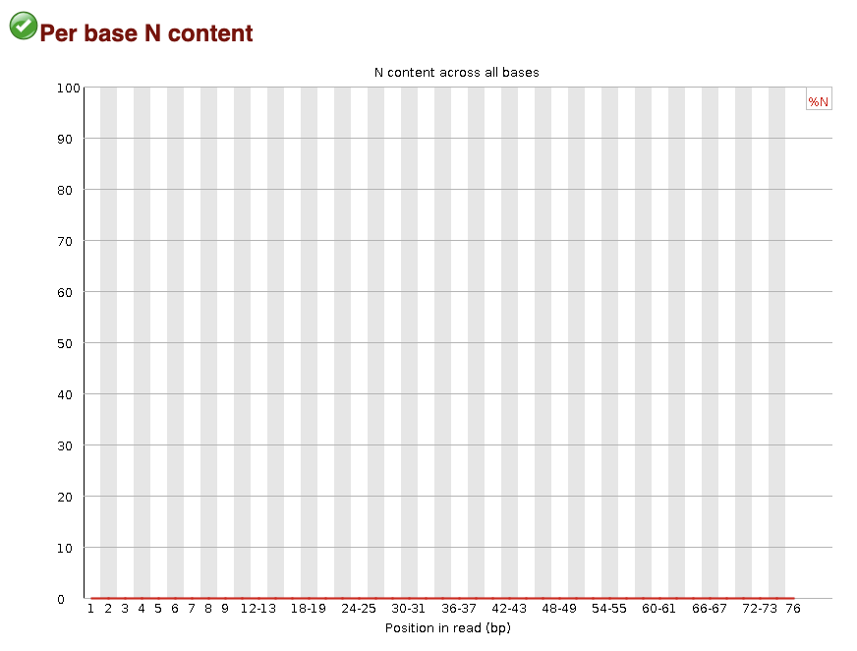
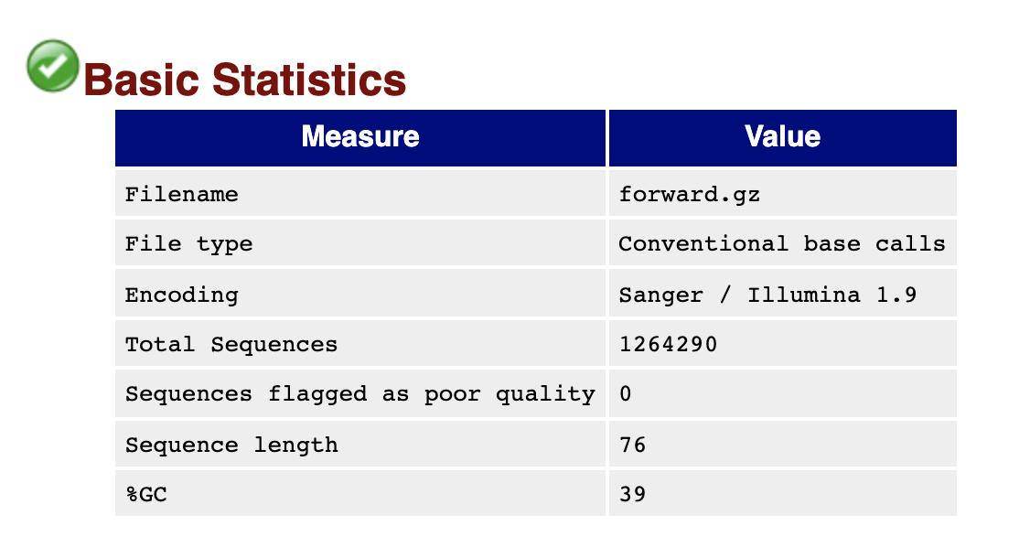
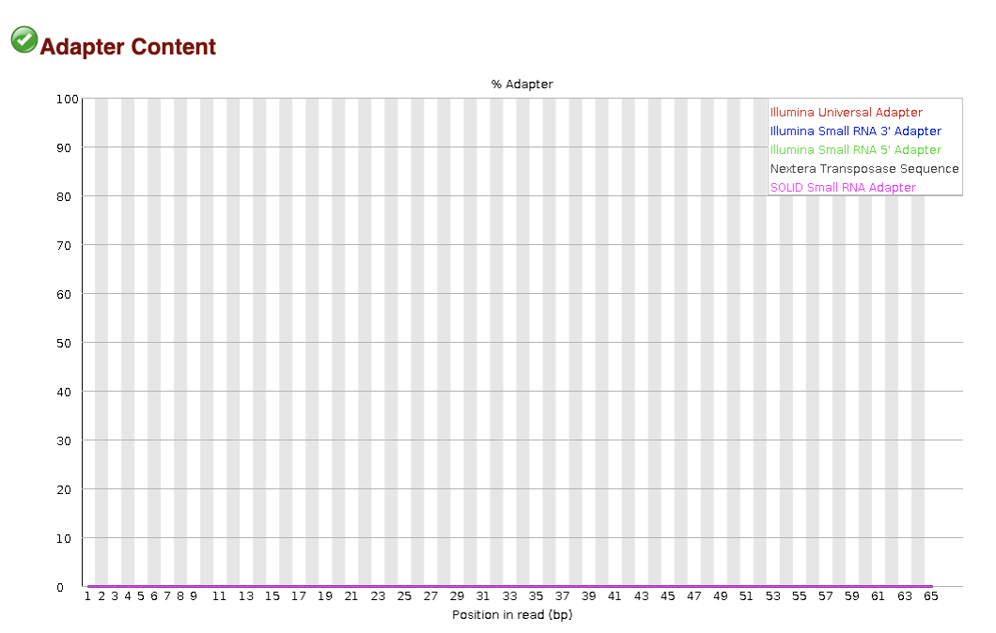

FastQC
Quality
Characteristics

Slide 31
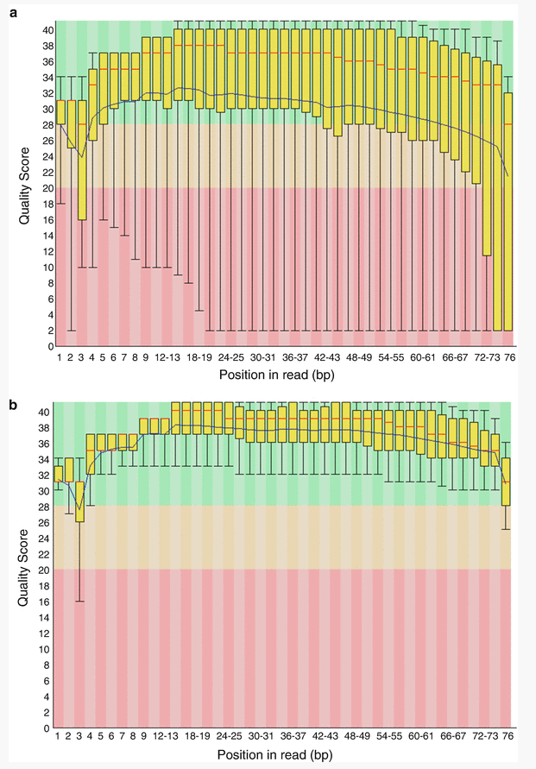
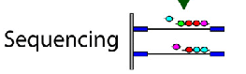
FastQC: Sequence Quality Histogram
Quality Score
Position in read (bp)
Position in read (bp)
GOOD
High quality over the length of the read
BAD
Read quality drops at the beginning and end

Slide 32
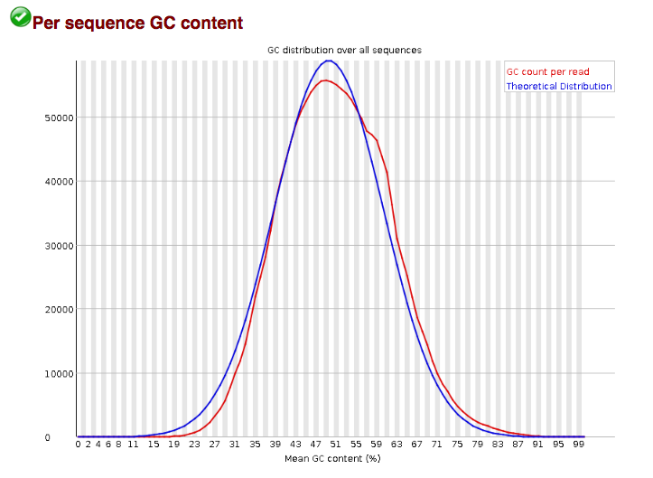
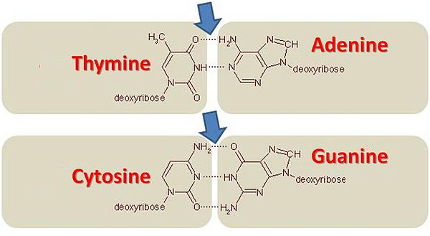
FastQC: Per sequence GC content
Number of Reads
Mean GC content (%)
Notes:
GC-content (or guanine-cytosine content) is the percentage of bases in a DNA or RNA molecule that are either G or C out of an implied four total bases.
The FastQC plot is a histogram of the number of reads on the y axis, and the mean GC % of the reads in that bin.
So this peaks around 50%, so most reads have between 40-60% of GC%

Slide 33
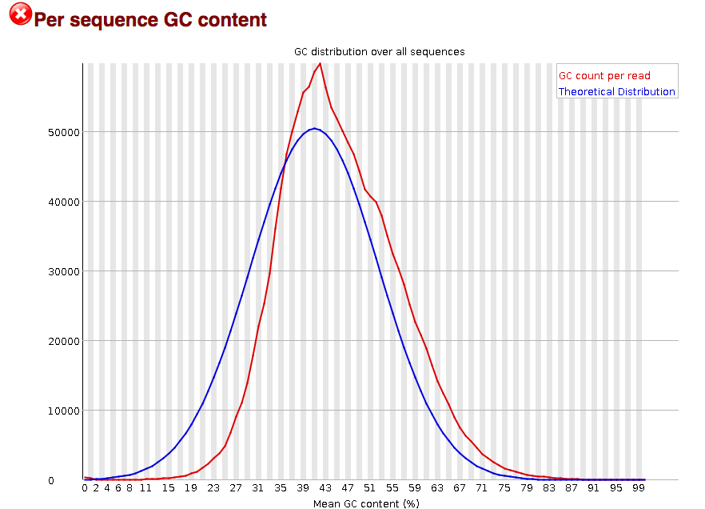
FastQC: Per sequence GC content
Number of Reads
Mean GC content (%)
Mean GC content (%)
Mean GC content (%)
GOOD: follows normal distribution (sum of deviations is < 15% of reads)
BAD: can indicate contamination with adapter dimers, or another species
Notes:
In a normal random library you would expect to see a roughly normal distribution of GC content where the central peak corresponds to the overall GC content of the underlying genome.
Since we don't know the the GC content of the genome, a theoretical distribution (blue) is created based on observed distribution.
An unusually shaped distribution could indicate a contaminated library or some other kinds of biased subset of reads mixed in.
Sharp peaks on an otherwise smooth distribution are normally the result of a specific contaminant (adapter dimers for example), which may well be picked up by the overrepresented sequences module. Broader peaks may represent contamination with a different species.

Slide 34
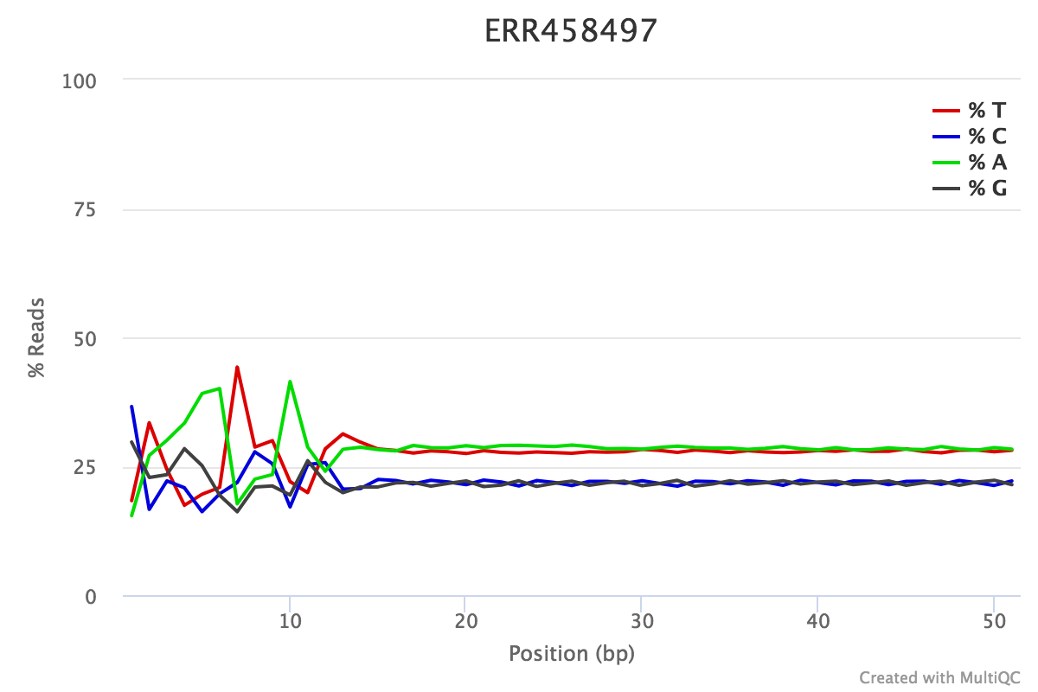
FastQC: Per Base Sequence Content
% Reads
Position (bp)
Proportion of each position for which each DNA base has been called
RNAseq data tends to show a positional sequence bias in the first ~12 bases
The "random" priming step during library construction is not truly random and certain hexamers are more prevalent than others
sequencing.qcfail.com
Notes:
This plot shows the position along the read ( x axis) and the proportion of all reads for which each DNA base has been called (y axis)
RNAseq data tends to show a positional sequence bias in the first ~12 bases
The "random" priming step during library construction is not truly random and certain hexamers are more prevalent than others
Studies have shown that this does NOT cause mis-called bases or drastic bias in sequenced fragments Read quality drops at the beginning and end
This biased distribution is expected for RNAseq

Slide 35
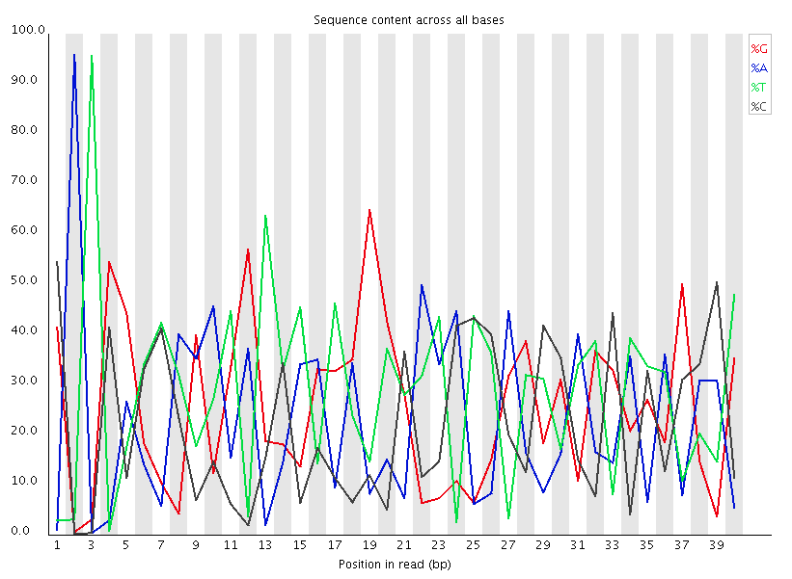
FastQC: Per Base Sequence Content
EXPECTED for RNAseq
BAD:
Shows a strong positional bias throughout the reads, which in this case is due to the library having a certain sequence that is overrepresented
Notes:
Could be adapter-dimer contamination or other

Slide 36
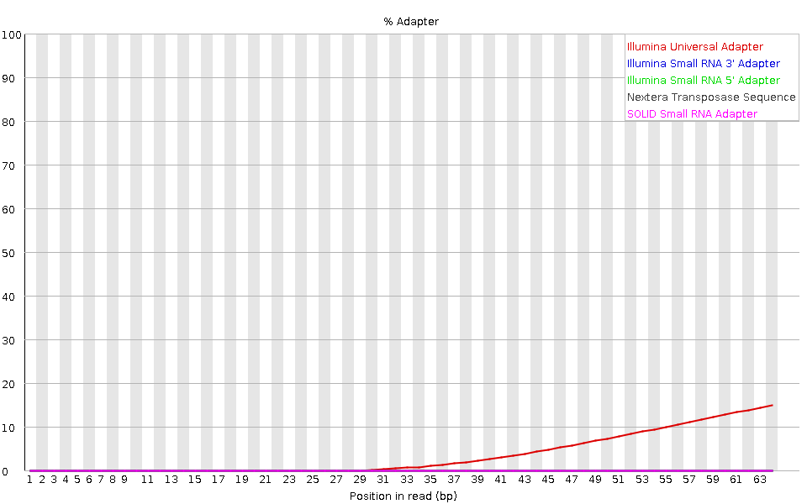
FastQC: Adapter content
Adapters
FastQC will scan each read for the presence of known adapter sequences
The plot shows that the adapter content rises over the course of the read
Solution – Adapter trimming!
Position in read (bp)
sequencing.qcfail.com

Slide 37
Create a new history

Slide 38
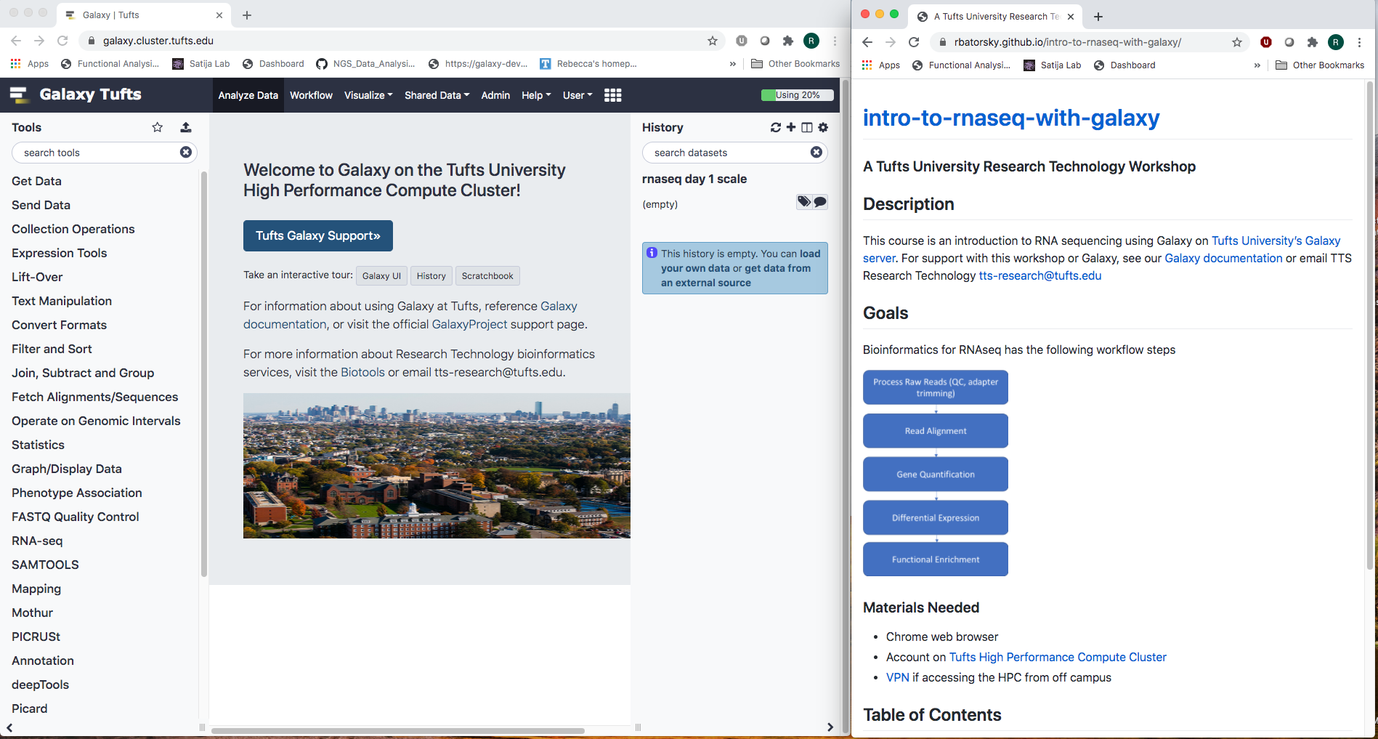
Access Galaxy
1. Connect to Tufts Network, either on campus or via VPN
2. Visit https://galaxy.cluster.tufts.edu/
3. Log in with you cluster username and password
4. In another browser window go to course workflow: https://rbatorsky.github.io/intro-to-galaxy-ngs-sarscov2/
Suggested screen layout

Slide 39
Outline
Bulk and single cell RNA sequencing
Intro to Galaxy Platform for Bioinformatics (Tufts network or VPN required)
https://galaxy.cluster.tufts.edu/
Work through RNAseq example together on Galaxy
https://rbatorsky.github.io/intro-to-rnaseq-with-galaxy/
2 days!
Notes:
I’d prefer you use the raise hand to ask question and lower it after. If I don’t see it, feel free to interrupt.
Can I get a show of hands of who has experience in bioinformatics?
How about anyone with experience in NGS sequencing?
With Galaxy?

Slide 40
>NC_045512.2 Severe acute respiratory syndrome coronavirus 2 isolate Wuhan-Hu-1, complete genome
ATTAAAGGTTTATACCTTCCCAGGTAACAAACCAACCAACTTTCGATCTCTTGTAGATCTGTTCTCTAAACGAACTTTAA
AATCTGTGTGGCTGTCACTCGGCTGCATGCTTAGTGCACTCACGCAGTATAATTAATAACTAATTACTGTCGTTGACAGG
ACACGAGTAACTCGTCTATCTTCTGCAGGCTGCTTACGGTTTCGTCCGTGTTGCAGCCGATCATCAGCACATCTAGGTTT
Sequence identifier
Sequence

Slide 41
>NC_045512.2 Severe acute respiratory syndrome coronavirus 2 isolate Wuhan-Hu-1, complete genome
ATTAAAGGTTTATACCTTCCCAGGTAACAAACCAACCAACTTTCGATCTCTTGTAGATCTGTTCTCTAAACGAACTTTAA
AATCTGTGTGGCTGTCACTCGGCTGCATGCTTAGTGCACTCACGCAGTATAATTAATAACTAATTACTGTCGTTGACAGG
ACACGAGTAACTCGTCTATCTTCTGCAGGCTGCTTACGGTTTCGTCCGTGTTGCAGCCGATCATCAGCACATCTAGGTTT
Sequence identifier
Sequence

Slide 42
Raw reads in Fastq format
@SRR098401.109756285
GACTCACGTAACTTTAAACTCTAACAGAAATATACTA…
+
CAEFGDG?BCGGGEEDGGHGHGDFHEIEGGDDDD…
Sequence identifier
Sequence
+ (optionally lists the sequence identifier again)
Quality string

Slide 43
Raw reads in Fastq format
@SRR098401.109756285
GACTCACGTAACTTTAAACTCTAACAGAAATATACTA…
+
CAEFGDG?BCGGGEEDGGHGHGDFHEIEGGDDDD…
Sequence identifier
Sequence
+ (optionally lists the sequence identifier again)
Quality string

Slide 44
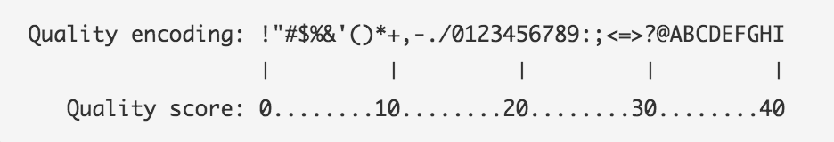
Base Quality Scores
The symbols we see in the read quality string are an encoding of the quality score:
A quality score is a prediction of the probability of an error in base calling:
Quality Score | Probability of Incorrect Base Call | Inferred Base Call Accuracy
10 (Q10) | 1 in 10 | 90%
20 (Q20) | 1 in 100 | 99%
30 (Q30) | 1 in 1000 | 99.9%
https://www.illumina.com/science/education/sequencing-quality-scores.html
Notes:
Q = -log_10(e), e = probability of error

Slide 45
Base Quality Scores
The symbols we see in the read quality string are an encoding of the quality score:
A quality score is a prediction of the probability of an error in base calling:
Quality Score | Probability of Incorrect Base Call | Inferred Base Call Accuracy
10 (Q10) | 1 in 10 | 90%
20 (Q20) | 1 in 100 | 99%
30 (Q30) | 1 in 1000 | 99.9%
Back to our read:
@SRR098401.109756285
GACTCACGTAACTTTAAACTCTAACAGAAATATACTA…
+
CAEFGDG?BCGGGEEDGGHGHGDFHEIEGGDDDD…
C –> Q = 34 -> Probability < 1/1000 of an error
https://www.illumina.com/science/education/sequencing-quality-scores.html

Slide 46
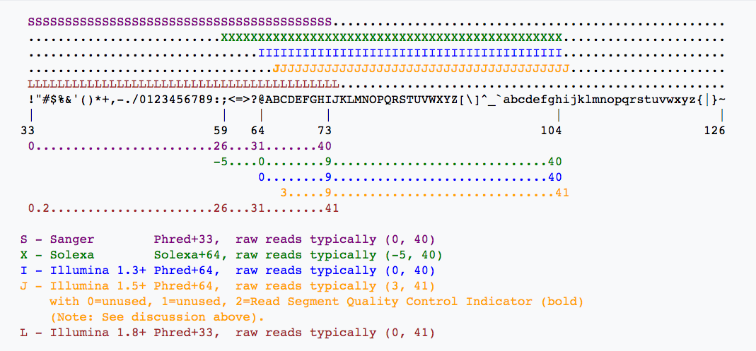
Base Quality Scores
Quality encoding
Quality scores
https://en.wikipedia.org/wiki/FASTQ_format

Slide 47
Raw read quality control
Sequence Quality
GC content
Per base sequence content
Adapters in Sequence

Slide 48
Let’s do it
In order to count genes, we need to know where they are located in the reference sequence
STAR uses a Gene Transfer Format (GTF) file for gene annotation
Frame
Strand
Chrom
Source
Feature type
Start
Stop
(Score)
Attribute
SeqID | Source | Type | Start | End | Score | Strand | Phase | Attributes
## HEADER LINES
NC_045512.2 | RefSeq | region | 1 | 29903 | . | + | . | ID=NC_045512.2:1..29903
NC_045512.2 | RefSeq | gene | 266 | 21555 | . | + | . | ID=gene-GU280_gp01
NC_045512.2 | RefSeq | CDS | 266 | 13468 | . | + | 0 | ID=cds-YP_009724389.1

Slide 49
FastQC: Sequence Quality Histogram
Quality Score
Position in read (bp)
Position in read (bp)
GOOD
High quality over the length of the read
BAD
Read quality drops at the beginning and end

Slide 50
FastQC: Per sequence GC content
Number of Reads
Mean GC content (%)
Notes:
GC-content (or guanine-cytosine content) is the percentage of bases in a DNA or RNA molecule that are either G or C out of an implied four total bases.
The FastQC plot is a histogram of the number of reads on the y axis, and the mean GC % of the reads in that bin.
So this peaks around 50%, so most reads have between 40-60% of GC%

Slide 51
FastQC: Per sequence GC content
Number of Reads
Mean GC content (%)
Mean GC content (%)
Mean GC content (%)
GOOD: follows normal distribution (sum of deviations is < 15% of reads)
BAD: can indicate contamination with adapter dimers, or another species
Notes:
In a normal random library you would expect to see a roughly normal distribution of GC content where the central peak corresponds to the overall GC content of the underlying genome.
Since we don't know the the GC content of the genome, a theoretical distribution (blue) is created based on observed distribution.
An unusually shaped distribution could indicate a contaminated library or some other kinds of biased subset of reads mixed in.
Sharp peaks on an otherwise smooth distribution are normally the result of a specific contaminant (adapter dimers for example), which may well be picked up by the overrepresented sequences module. Broader peaks may represent contamination with a different species.

Slide 52
FastQC: Per Base Sequence Content
% Reads
Position (bp)
Proportion of each position for which each DNA base has been called
RNAseq data tends to show a positional sequence bias in the first ~12 bases
The "random" priming step during library construction is not truly random and certain hexamers are more prevalent than others
sequencing.qcfail.com
Notes:
This plot shows the position along the read ( x axis) and the proportion of all reads for which each DNA base has been called (y axis)
RNAseq data tends to show a positional sequence bias in the first ~12 bases
The "random" priming step during library construction is not truly random and certain hexamers are more prevalent than others
Studies have shown that this does NOT cause mis-called bases or drastic bias in sequenced fragments Read quality drops at the beginning and end
This biased distribution is expected for RNAseq

Slide 53
FastQC: Per Base Sequence Content
EXPECTED for RNAseq
BAD:
Shows a strong positional bias throughout the reads, which in this case is due to the library having a certain sequence that is overrepresented
Notes:
Could be adapter-dimer contamination or other

Slide 54
FastQC: Adapter content
Adapters
FastQC will scan each read for the presence of known adapter sequences
The plot shows that the adapter content rises over the course of the read
Solution – Adapter trimming!
Position in read (bp)
sequencing.qcfail.com

Slide 55
Adapter trimming
Trim Galore! is a tool that:
Scans and removes known Illumina or custom adapters
Performs read trimming for low quality regions at the end of reads
Removes reads that become too short in the trimming process

Slide 56
Our Workflow
Obtain data from NCBI
Process Raw Reads (QC, adapter trimming)
Read Alignment
Visualization
Notes:
Note that this will get pretty technical pretty quickly, with the nuts and bolts of the RNAseq workflow.
I expect you will be able to follow the slides, but please feel free to ask questions.
After this overview, we’ll go through it together and perform the steps.

Slide 57
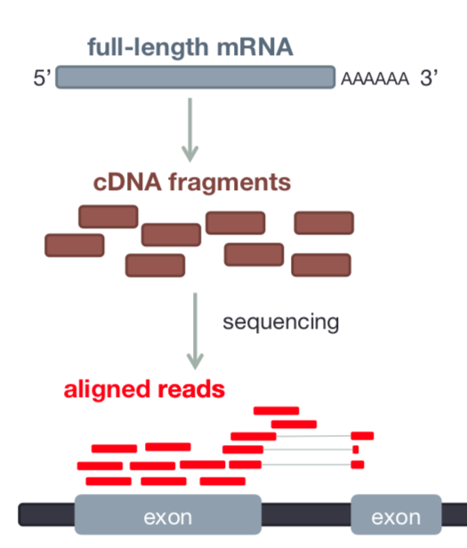
Read Alignment
RNAseq data originates from spliced mRNA (no introns)
When aligning to the genome, our aligner must find a spliced alignment for reads
We use a tool called STAR (Spliced Transcripts Alignment to a Reference) that has a exon-aware mapping algorithm.
Reference sequence
Dobin et al Bioinformatics 2013

Slide 58
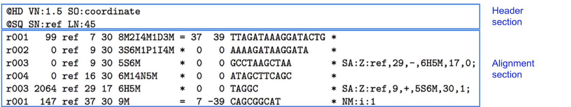
Sequence Alignment Map (SAM)
Reference seq
Reads
TTAGAT
GATAAC
CIGAR: summary of alignment, e.g. match, gap, insertion, deletion
Mapping Quality
Position
Ref Sequence name
Flag: indicates alignment information e.g. paired, aligned, etc
https://broadinstitute.github.io/picard/explain-flags.html
Read ID
www.samformat.info

Slide 59
Sequence Alignment Map (SAM)
Reference seq
Reads
TTAGAT
GATAAC
Paired end info
Optional Fields
Quality Score
Sequence
www.samformat.info

Slide 60
Gene Annotation Format (GTF)
In order to count genes, we need to know where they are located in the reference sequence
STAR uses a Gene Transfer Format (GTF) file for gene annotation
Frame
Strand
Chrom
Source
Feature type
Start
Stop
(Score)
Attribute
chr5 | hg38_refGene | exon | 138465492 | 138466068 | . | + | . | gene_id "EGR1";
chr5 | hg38_refGene | CDS | 138465762 | 138466068 | . | + | 0 | gene_id "EGR1";
chr5 | hg38_refGene | start_codon | 138465762 | 138465764 | . | + | . | gene_id "EGR1";
chr5 | hg38_refGene | CDS | 138466757 | 138468078 | . | + | 2 | gene_id "EGR1";
chr5 | hg38_refGene | exon | 138466757 | 138469315 | . | + | . | gene_id "EGR1";
chr5 | hg38_refGene | stop_codon | 138468079 | 138468081 | . | + | . | gene_id "EGR1";
https://useast.ensembl.org/info/website/upload/gff.html

Slide 61
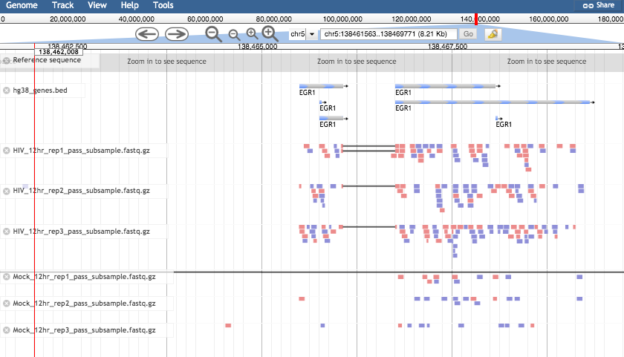
Visualizing reads with JBrowse

Slide 62
SARS-CoV lifecycle
Point out RNA
Point out Spike
https://www.nature.com/articles/nrmicro2090
Notes:
Severe acute respiratory syndrome-coronavirus (SARS-CoV) enters target cells through an endosomal pathway^{113,121,125,126,127}. S protein first binds to the cellular receptor angiotensin-converting enzyme 2 (ACE2)¹²⁹, and the ACE2–virus complex is then translocated to endosomes, where S protein is cleaved by the endosomal acid proteases (cathepsin L)¹⁰⁵ to activate its fusion activity. The viral genome is released and translated into viral replicase polyproteins pp1a and 1ab, which are then cleaved into small products by viral proteinases. Subgenomic negative-strand templates are synthesized from discontinuous transcription on the plus-strand genome and serve as templates for mRNA synthesis. The full-length negative-strand template is made as a template for genomic RNA. Viral nucleocapsids are assembled from genomic RNA and N protein in the cytoplasm, followed by budding into the lumen of the ERGIC (endoplasmic reticulum (ER)–Golgi intermediate compartment)¹²⁸. Virions are then released from the cell through exocytosis.

Slide 63
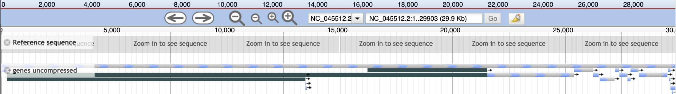
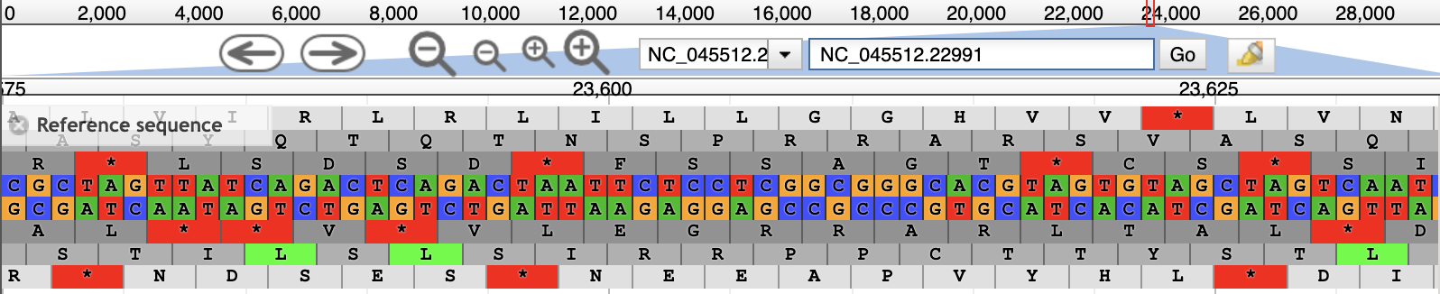
Genome coordinates bar, click and drag to select region corresponding to Spike protein
Spike protein
Enter 22,991 after colon

